Slide 1
IMDB MOVIE ANALYSIS
BY ABHISHEK BHAKAT
MAY 2025

Slide 2
Agenda
01. PROJECT DESCRIPTION
02. APPROACH
03. TECH-STACK USED
04. INSIGHTS
05. RESULTS

Slide 3

PROJECT DESCRIPTION
This project, titled “IMDB Movie Analysis”, focuses on exploring the key factors that contribute to a movie's success on the IMDB platform. Success, in this context, is defined by high IMDB ratings. By analyzing a real-world dataset of movies, the project aims to uncover patterns and insights that can help filmmakers, producers, directors, and investors make more informed decisions about future film projects.
ThePhoto by PhotoAuthor is licensed under CCYYSA.

Slide 4
APPROACH
DATA CLEANING
Handled missing values and removed duplicates
Standardized data formats (e.g., genres, duration, budget)
Converted necessary columns to appropriate data types
Created new calculated fields like profit margin

Slide 5
APPROACH
EXPLORATORY DATA ANALYSIS (EDA)
Analyzed genre distribution and their influence on IMDB ratings
Examined the relationship between movie duration and ratings
Studied language-wise rating trends
Identified top-performing directors using percentile scores
Calculated budget-to-earnings correlation and profit margins

Slide 6
APPROACH
STATISTICAL TECHENIQUES
Applied descriptive statistics: mean, median, mode, range, standard deviation, variance
Used correlation and trendline analysis to study relationships
Employed percentile and ranking techniques for deeper insights

Slide 7
APPROACH
VISUALIZATION
Used Excel charts like bar charts, scatter plots, and pie charts
Added trendlines to visualize correlation strength
Highlighted top insights using conditional formatting and visual cues

Slide 8

TECH-STACK USED
MICROSOFT EXCEL 365
Purpose: Data Cleaning, Analysis, Visualization, and Statistical Computation
Functions & Features Used:
COUNTIF, AVERAGE, MEDIAN, MODE, MAX, MIN, STDEV, VAR, CORREL, PERCENTILE
Pivot Tables for summarization and cross-tab analysis
Scatter plots, bar charts, pie charts, and trendlines for visualization
Conditional formatting for highlighting patterns
Data Filters and Sort functions for focused exploration

Slide 9

INSIGHTS

Slide 10
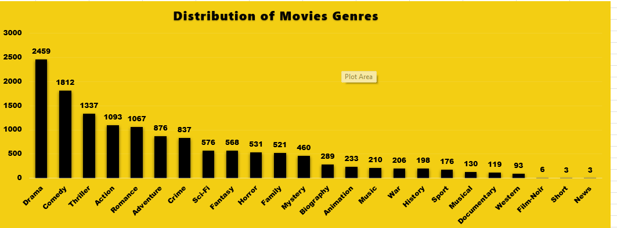
MOVIE GENRE ANALYSIS
TASK A : Analyze the distribution of movie genres and their impact on the IMDB score.
Task : Determine the most common genres of movies in the dataset. Then, for each genre, calculate descriptive statistics (mean, median, mode, range, variance, standard deviation) of the IMDB scores.

Slide 11
MOVIE GENRE ANALYSIS
INSIGHTS
Chart 1: Distribution of Movie Genres
Drama is the most produced genre with 2,459 movies, followed by Comedy (1,812) and Thriller (1,337).
These three genres make up a significant portion of the total movie dataset, indicating their popularity and widespread appeal.
Less common genres include Western (93), Film-Noir (6), Short (3), and News (3), suggesting niche interest or limited production.
Action, Romance, and Adventure also have substantial counts, highlighting strong viewer demand for excitement and emotional narratives.

Slide 12
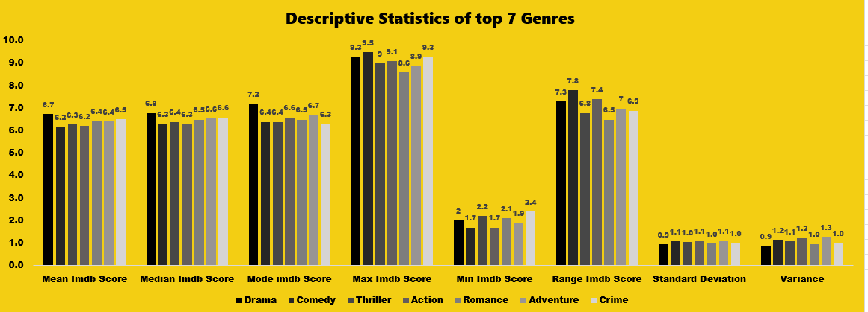
MOVIE GENRE ANALYSIS
Here is the descriptive statistics of the top 7 Genres

Slide 13
MOVIE GENRE ANALYSIS
INSIGHTS
Descriptive Statistics of Top 7 Genres :
Drama has the highest mean IMDb score (6.7) and median score (6.8), indicating consistent quality and viewer approval.
Comedy has the highest mode IMDb score (7.2) and a relatively high maximum score (9.5), showing that while average ratings are moderate, some comedies perform exceptionally well.
Thriller has the widest range in IMDb scores (7.8), suggesting varying quality across thriller movies.
Adventure has the lowest minimum score (1.7) and highest variance (1.3), indicating high inconsistency in viewer ratings.
Crime and Action also show relatively high variation, with standard deviations around 1.1.
Overall, Drama and Comedy offer the most reliable viewing experiences in terms of average ratings and consistency.

Slide 14
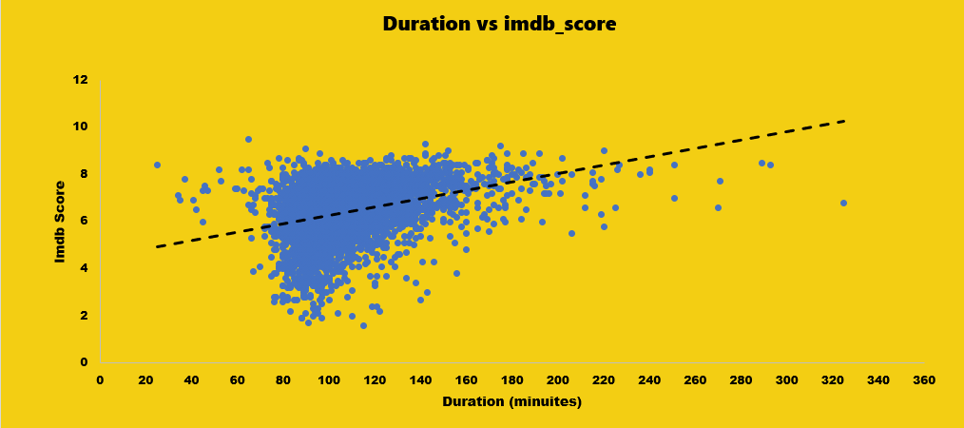
MOVIE DURATION ANALYSIS
TASK B : Analyze the distribution of movie durations and its impact on the IMDB score.
Analyze the distribution of movie durations and identify the relationship between movie duration and IMDB score.

Slide 15
MOVIE DURATION ANALYSIS
INSIGHTS
Duration vs Imdb Score :
The scatter plot shows a positive correlation between movie duration and IMDb score, as indicated by the upward trend of the regression line.
This suggests that longer movies tend to receive higher IMDb scores on average, although the relationship is not very strong.
The majority of movies fall between 80 and 150 minutes, with scores mostly ranging from 5 to 8.
A few outliers exist — very short or very long movies with unusually high or low scores, but they are rare.

Slide 16
MOVIE DURATION ANALYSIS
Descriptive Statistics for Duration
MEAN | MEDIAN | STANDARD DEVIATION
108.02 | 104 | 21.98

Slide 17
MOVIE DURATION ANALYSIS
INSIGHTS
Descriptive Statistics for Movie Duration :
The average movie duration is 108.02 minutes, with a median of 104 minutes, indicating a slightly right-skewed distribution (some longer movies).
The standard deviation is 21.98 minutes, meaning most movies fall within the range of approximately 86 to 130 minutes.

Slide 18
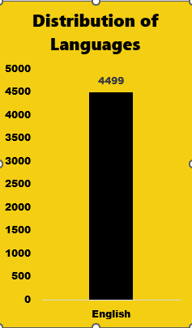
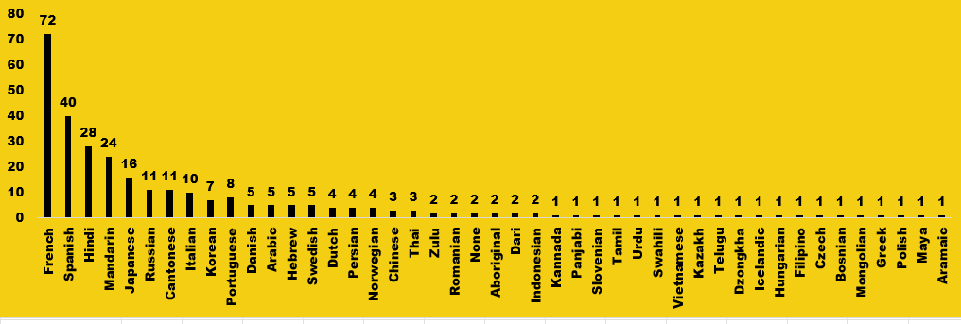
LANGUAGE ANALYSIS
TASK C : Examine the distribution of movies based on their Language.
Determine the most common language used in the movies and analyze their impact on IMDB score using descriptive statistics.

Slide 19
LANGUAGE ANALYSIS
INSIGHTS
Distribution of Languages :
English dominates the dataset, with 4499 movies, far more than any other language.
French (72), Spanish (40), Hindi (28), Mandarin (24), and Japanese (16) are the next most common languages, but they appear in significantly lower numbers.
Most of the other languages are underrepresented (less than 10 movies), and many (like Tamil, Urdu, Vietnamese, etc.) have only 1 movie.
This skewed distribution suggests that English-language films are overrepresented, possibly due to greater global production and/or availability in datasets.

Slide 20
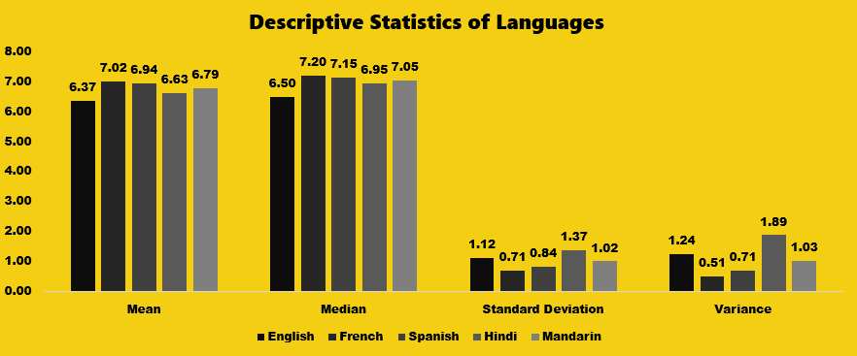
LANGUAGE ANALYSIS
Descriptive statistics of Languages

Slide 21
LANGUAGE ANALYSIS
INSIGHTS
Descriptive Statistics of Languages:
French and Spanish movies have the highest average IMDb scores:
Mean IMDb Score: French (7.02), Spanish (6.94), Mandarin (6.79)
English movies have a lower mean of 6.37.
Median scores follow a similar trend, indicating consistent audience approval for French and Spanish movies.
Hindi movies have the highest variance (1.89), meaning the quality of Hindi movies varies significantly — some perform very well, others poorly.
French movies have the lowest standard deviation (0.71), suggesting that they are more consistent in quality.
While English movies are the most produced, their average ratings are lower and more variable than some of the less represented languages.

Slide 22
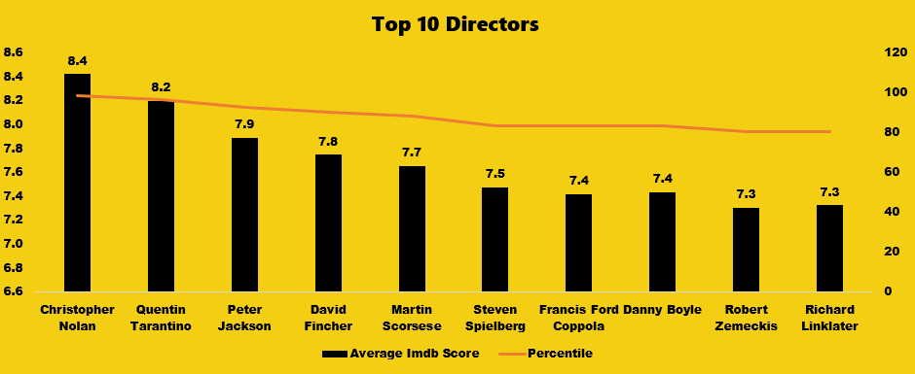
DIRECTOR ANALYSIS
TASK D : Influence of directors on movie ratings
Identify the top directors based on their average IMDB score and analyze their contribution to the success of movies using percentile calculations.

Slide 23
DIRECTOR ANALYSIS
INSIGHTS
Top Directors:
Christopher Nolan stands out with the highest average IMDb score of 8.4 and is placed in the topmost percentile, indicating widespread critical and audience acclaim.
Quentin Tarantino follows with an 8.2 average score, also within a very high percentile, reflecting a consistently strong filmography.
Peter Jackson (7.9), David Fincher (7.8), and Martin Scorsese (7.7) also rank in high percentiles, showing that their work is highly appreciated in the industry.
As we move down the list to Steven Spielberg, Francis Ford Coppola, and Danny Boyle (7.4–7.5 scores), there’s a slight dip in average ratings, but the percentile remains relatively stable.
Robert Zemeckis and Richard Linklater, with 7.3 average scores, still maintain a good percentile, affirming their solid reputations.
The orange line (Percentile) shows a slight downward trend, indicating a small decline in relative standing, but all directors remain in the top quartile of performance.

Slide 24
DIRECTOR ANALYSIS
IMDB score and percentile insights
Director Name | Average Imbd score | Count of Movies | Percentile
Christopher Nolan | 8.4 | 8 | 98.7
Quentin Tarantino | 8.2 | 8 | 96.8
Peter Jackson | 7.9 | 9 | 92.7
David Fincher | 7.8 | 10 | 90.7
Martin Scorsese | 7.7 | 20 | 88.8
Steven Spielberg | 7.5 | 26 | 83.5
Francis Ford Coppola | 7.4 | 11 | 83.5
Danny Boyle | 7.4 | 8 | 83.5
Robert Zemeckis | 7.3 | 13 | 80.6
Richard Linklater | 7.3 | 11 | 80.6

Slide 25
DIRECTOR ANALYSIS
INSIGHTS
Top 10 Directors & Percentile:
Christopher Nolan and Quentin Tarantino lead with the highest IMDb scores (8.4 & 8.2) and percentiles (98.7% & 96.8%), despite directing only 8 movies each—showing consistent excellence.
Peter Jackson, David Fincher, and Martin Scorsese maintain high ratings (7.7–7.9) with solid percentiles, proving both quality and volume in their filmography.
Steven Spielberg, with the highest movie count (26), has a slightly lower average (7.5) but remains in the top 83.5 percentile, reflecting his wide-ranging contributions to cinema.
All listed directors are in the top 20% (≥80th percentile), reinforcing their positions as critically respected and influential filmmakers.

Slide 26
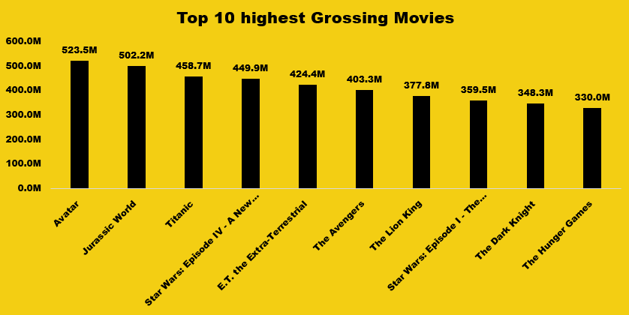
BUDGET ANALYSIS
TASK E : Explore he relationship between movie budget and their financial success
Analyze the correlation between movie budgets and gross earnings, and identify the movies with the highest profit margin.

Slide 27
BUDGET ANALYSIS
INSIGHTS
Top 10 Highest Grossing Movies:
Avatar tops the chart with a massive $523.5M, followed closely by Jurassic World ($502.2M) and Titanic ($458.7M) — all crossing the $450M mark.
Franchises dominate the list, including Star Wars (2 entries), The Avengers, and The Dark Knight, highlighting the power of cinematic universes.
The Lion King and E.T. show that even animated and older classics can compete strongly with modern blockbusters.
The revenue gap between the top and bottom film is nearly $194M, underlining the varying scale of box office success even within the top 10.

Slide 28
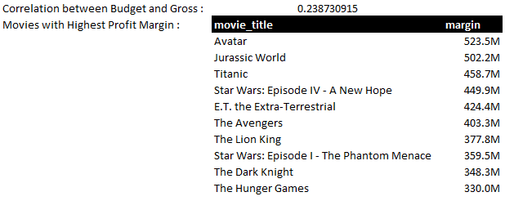
BUDGET ANALYSIS
Gross vs Budget Correlation

Slide 29
BUDGET ANALYSIS
INSIGHTS
Gross vs budget Correlation :
Weak Positive Correlation: The correlation of 0.2384 suggests a very weak positive relationship — as one variable (e.g., number of movies directed) increases, the other (e.g., average IMDb score) only slightly tends to increase, but not strongly or consistently.
Quality ≠ Quantity: Directors who make more movies don't necessarily have higher IMDb scores. This implies that movie quality (ratings) is not directly dependent on the quantity of movies produced.
Other Factors at Play: Since the correlation is weak, it indicates that other variables — like genre, storytelling, star cast, or audience trends — may have a greater impact on a movie’s IMDb score or success.

Slide 30
RESULTS
The IMDB Movie Analysis project successfully identified key factors that influence a movie’s rating and financial performance. By applying data cleaning, statistical analysis, and Excel-based visualizations, the project delivered:
A deeper understanding of how genres, duration, language, director reputation, and budget impact movie success.
Clear evidence that quality direction and mid-to-high budgets often correlate with higher IMDB ratings and better returns.
Actionable insights that filmmakers, producers, and investors can use to make data-driven decisions for future projects.
This project enhanced my analytical thinking, Excel proficiency, and ability to extract valuable business insights from raw data.

Slide 31

Thank you
Abhishek Bhakat
abhishekbhakat6@gmail.com
Link to dataset : Dataset

